Slide 1
What would you do?
21. Would: hypothetical situations, offers, requests

Slide 2
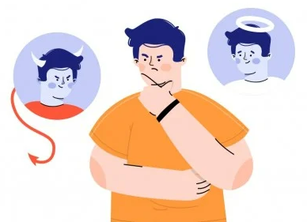
Hypothetical situations and dilemmas
You hit a car in a parking lot, but there is no one around.
You are offered money to promote something you don’t believe in.
You discover an app spies everyone, but you can use that information.
You find out your best friend’s partner is cheating.
What would you do?

Slide 3
Would
We use would to talk about hypothetical situations.
Subject + would+ verb in base form.
You would get a raise.
I wouldn’t get a second job.
Polite offers
Would you like to sit down?
Would you like a cup of tea? Yes, I would. No, thank you.
Polite requests
I would like a cup of coffee.
Would you please send the report?

Slide 4
Complete these ideas
If I were rich, I would…
If she had more time, she would…
If he could spend more time with his family, he would…
If it snowed tomorrow, we would…
It is a bit chilly, would you…?
I don’t know this word, would you…?
I don’t have enough time, would you…?
I don’t understand the rules, would you…?

Slide 5

Discuss with a friend
You pass someone on the road whose car has a flat tire. What would you do?
You are watching the lottery draw on TV and discover you have the winning ticket. What would you do?
You arrive home and find that your house is on fire. What would you do?
The local travel agency holds a raffle. You win a plane ticket to anywhere in the world. Where would you go? Why would you go there?
You can choose anything in the best store. Which present would you choose? Why would you choose it?
You are asked to write an article for the local newspaper. What would you write about? Why would you write about that?

Slide 6
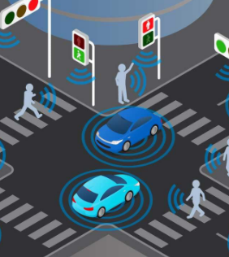
Moral machine
You will see two scenarios of a self-driving car
You must choose the lesser of two evils and explain why.
https://www.moralmachine.net/
Notes:
https://www.moralmachine.net/

